Slide 1
Two sample t-test, z-test
Prepared By:
Utsav Baral (Roll no. : 10)

Slide 2
Two sample t-test
The two-sample t-test (also known as independent samples t-test) is a method used to test whether the unknown population means of two groups are equal or not.
You can use the test when your data values are independent, are randomly sampled from two normal populations and the two independent groups have equal variances.
Sample must me taken from two different populations.
Sample size must be less than 30, If sample size is more than 30 then we use z-test.

Slide 3
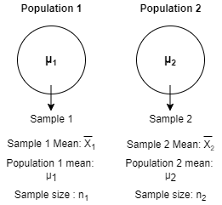
Let there be two populations and their samples be sample 1 and sample 2 with sample size n₁ and n₂ respectively.
Let mean of population 1 be 𝝻₁ and mean of population 2 be 𝝻₂.
Let mean of sample 1 be X̅₁ and mean of sample 2 be X̅₂.
Now here we get extra assumption that is variance of population 1 (𝛔₁²) and population 2 (𝛔₂²) must be equal. I.e. (𝛔₁²) = (𝛔₂²) = 𝛔².
When we talk about two independent samples, the standard deviation of population is unknown but we say both are equal for practical purpose.

Slide 4
Null Hypothesis (H₀) : 𝝻₁ = 𝝻₂
Alternate Hypothesis (H₁) = 𝝻₁≠ 𝝻₂
Test statistics (t) = (X̅₁- X̅₂) / 𝛔_{X̅}
Where, 𝛔_{X̅} = Standard error of mean
Standard error of mean is applied if variance or Standard deviation of both population is equal.
𝛔_{X̅} = s √ (1/n₁ + 1/n₂)
Or, t = ((X̅₁- X̅₂) / s) x √ ((n₁.n₂) / (n₁+n₂))
where s = Combined standard deviation
s=√((∑(x₁- x̅₁)² + ∑(x₂- x̅₂)² ) / n₁+n₂-2)
s = [n₁[𝛔₁²+(X̅₁- X̅_{C})²] + n₂[𝛔₂²+(X̅₂- X̅_{C})²]] / (n₁+n₂)
where , X̅_{C} = (n₁X̅₁+ n₂X̅₂) / (n₁+n₂)
Degree of freedom = n₁+n₂-2
When we take samples from two different populations and we want to find the average difference of those samples then we use t-test.
Sample size might differ from samples taken from both populations.
For eg: Sample 1 = Teacher’s height, Sample 2 = Student’s height. It’s not compulsory that n1 = n2. So now we must find out if Teacher’s height is less or more than Student’s height.
So for null hypothesis we assume that 𝝻₁= 𝝻₂. And for alternate hypothesis, we assume that 𝝻₁≠ 𝝻₂.
Now we calculate test statistics (t) and compare it with tabulated (t) under certain degree of freedom and certain level of significance.
If calculated (t) lies between lowest tabulated (t) and highest tabulated (t) then we accept the null hypothesis.

Slide 5
Eg: A Statistics teacher wants to compare his two classes if they performed any differently on the tests he gave that semester. Class A had 25 students with average score of 70, standard deviation 15. Class B had 20 students with an average score of 74, standard deviation 25. Using alpha 0.05, did these two classes performed differently on the tests?
Define Null and Alternate Hypothesis Null (H₀) : 𝝻_{A} = 𝝻_{B} Alternate (H₁) : 𝝻_{A}≠ 𝝻_{B}
State alpha (ɑ) : Level of significance Ɑ = 0.05
Calculate degree of freedom df = n₁+n₂-2 = 25+20-2 = 43
Calculate test statistics (t) t = ((X̅₁- X̅₂) / s) x √ ((n₁.n₂) / (n₁+n₂)) or, t = ((70 - 74) / 401.74) x √((25x20) / (25+20)) or t = -0.67
Stating result Tabulated value at degree of freedom 43 and Ɑ = 0.05 is 2.0167 so, If calculated (t) is > 2.0167 or < -2.0167 then we reject the null hypothesis.
Since, t = -0.67 it falls between 2.0167 and -2.0167 so we accept null hypothesis i.e. there’s no significant difference between the test performance of class A and B.

Slide 6
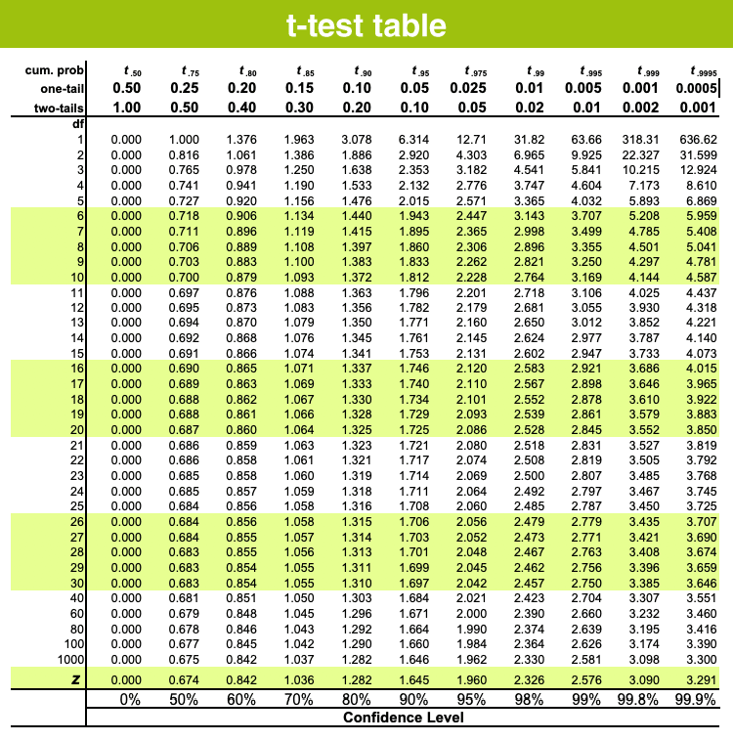

Slide 7
Z‐tests for differences between two populations means
A statistical test to determine whether two population means are different when the variances are known and the sample size is large.
Sample must me taken from two different populations.
Sample size must be greater than or equal to 30 , If sample size is less than 30 then we use t-test.

Slide 8
Let there be two populations and their samples be sample 1 and sample 2 with sample size n₁ and n₂ respectively.
Let mean of population 1 be 𝝻₁ and mean of population 2 be 𝝻₂.
Let mean of sample 1 be X̅₁ and mean of sample 2 be X̅₂.
Now here we know the variance of population 1 (𝛔₁²) and population 2 (𝛔₂²).

Slide 9
Sample size might differ from samples taken from both populations.
So for null hypothesis we assume that 𝝻₁= 𝝻₂. And for alternate hypothesis, we assume that 𝝻₁≠ 𝝻₂.
Now we calculate z statistics (z) and compare it with tabulated (z) under certain critical value of z and certain level of significance.
If calculated (z) lies between lowest tabulated (z) and highest tabulated (z) then we accept the null hypothesis.
Null Hypothesis (H₀) : 𝝻₁ = 𝝻₂
Alternate Hypothesis (H₁) = 𝝻₁≠ 𝝻₂
z statistics (z) = (X̅₁- X̅₂) / 𝛔_{X̅1 - X̅2}
Where, 𝛔_{X̅1 - X̅2} = Standard error of difference of mean
𝛔_{X̅1 - X̅2} = √((𝛔₁²/n₁) + (𝛔₂²/n₂))
Critical value (zɑ) : tabulated value of z at ɑ level of significance.

Slide 10
Eg: Intelligence test of two groups of boys and girls gave the following results:
Girls (A): Mean 75, S.D. 15 and Sample size 150 Boys (B): Mean 70, S.D. 20 and Sample size 250
Define Null and Alternate Hypothesis Null (H₀) : 𝝻_{A} = 𝝻_{B} Alternate (H₁) : 𝝻_{A}≠ 𝝻_{B}
State alpha (ɑ) : Level of significance Ɑ = 0.05
Calculate z statistics (z) 𝛔_{X̅1 - X̅2} = √((15²/150) + (20²/250)) = 1.761 z = (75-70) / 1.761 = 2.84
Calculate critical value (zɑ) using z-table
ɑ = 0.05 Zɑ = 1.96 at ɑ = 0.05
Stating result Critical value of Z at Ɑ = 0.05 is 1.96 so, If calculated (z) is >1.96 or < -1.96 then we reject the null hypothesis.
Since, z = 2.84 it is greater than tabulated critical value so we reject null hypothesis i.e. there’s significant difference between the intelligence between two groups.

Slide 11
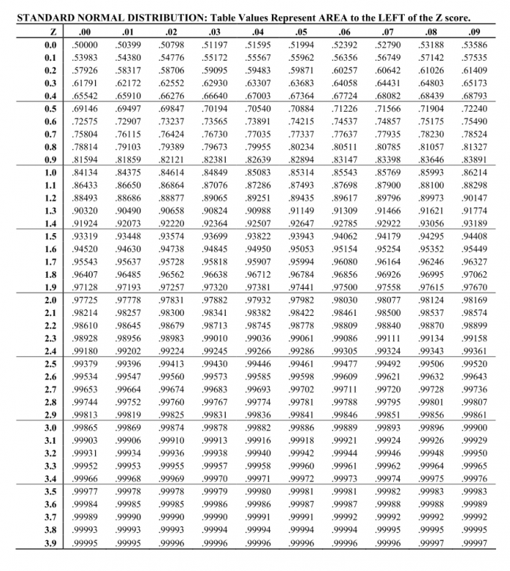

Slide 12
Thank You.
Any Queries?

